Slide 1
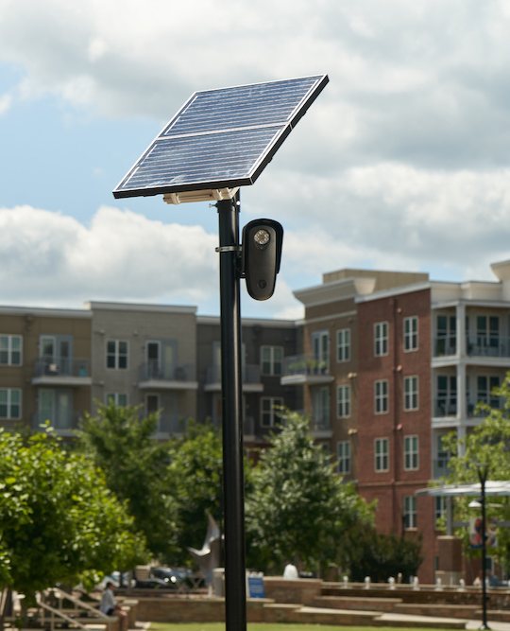
Protecting Civil Liberties and Standing By Our Community's Values
Gideon Epstein
Policy Counsel, Technology for Liberty Program
ACLU of Massachusetts

Slide 2
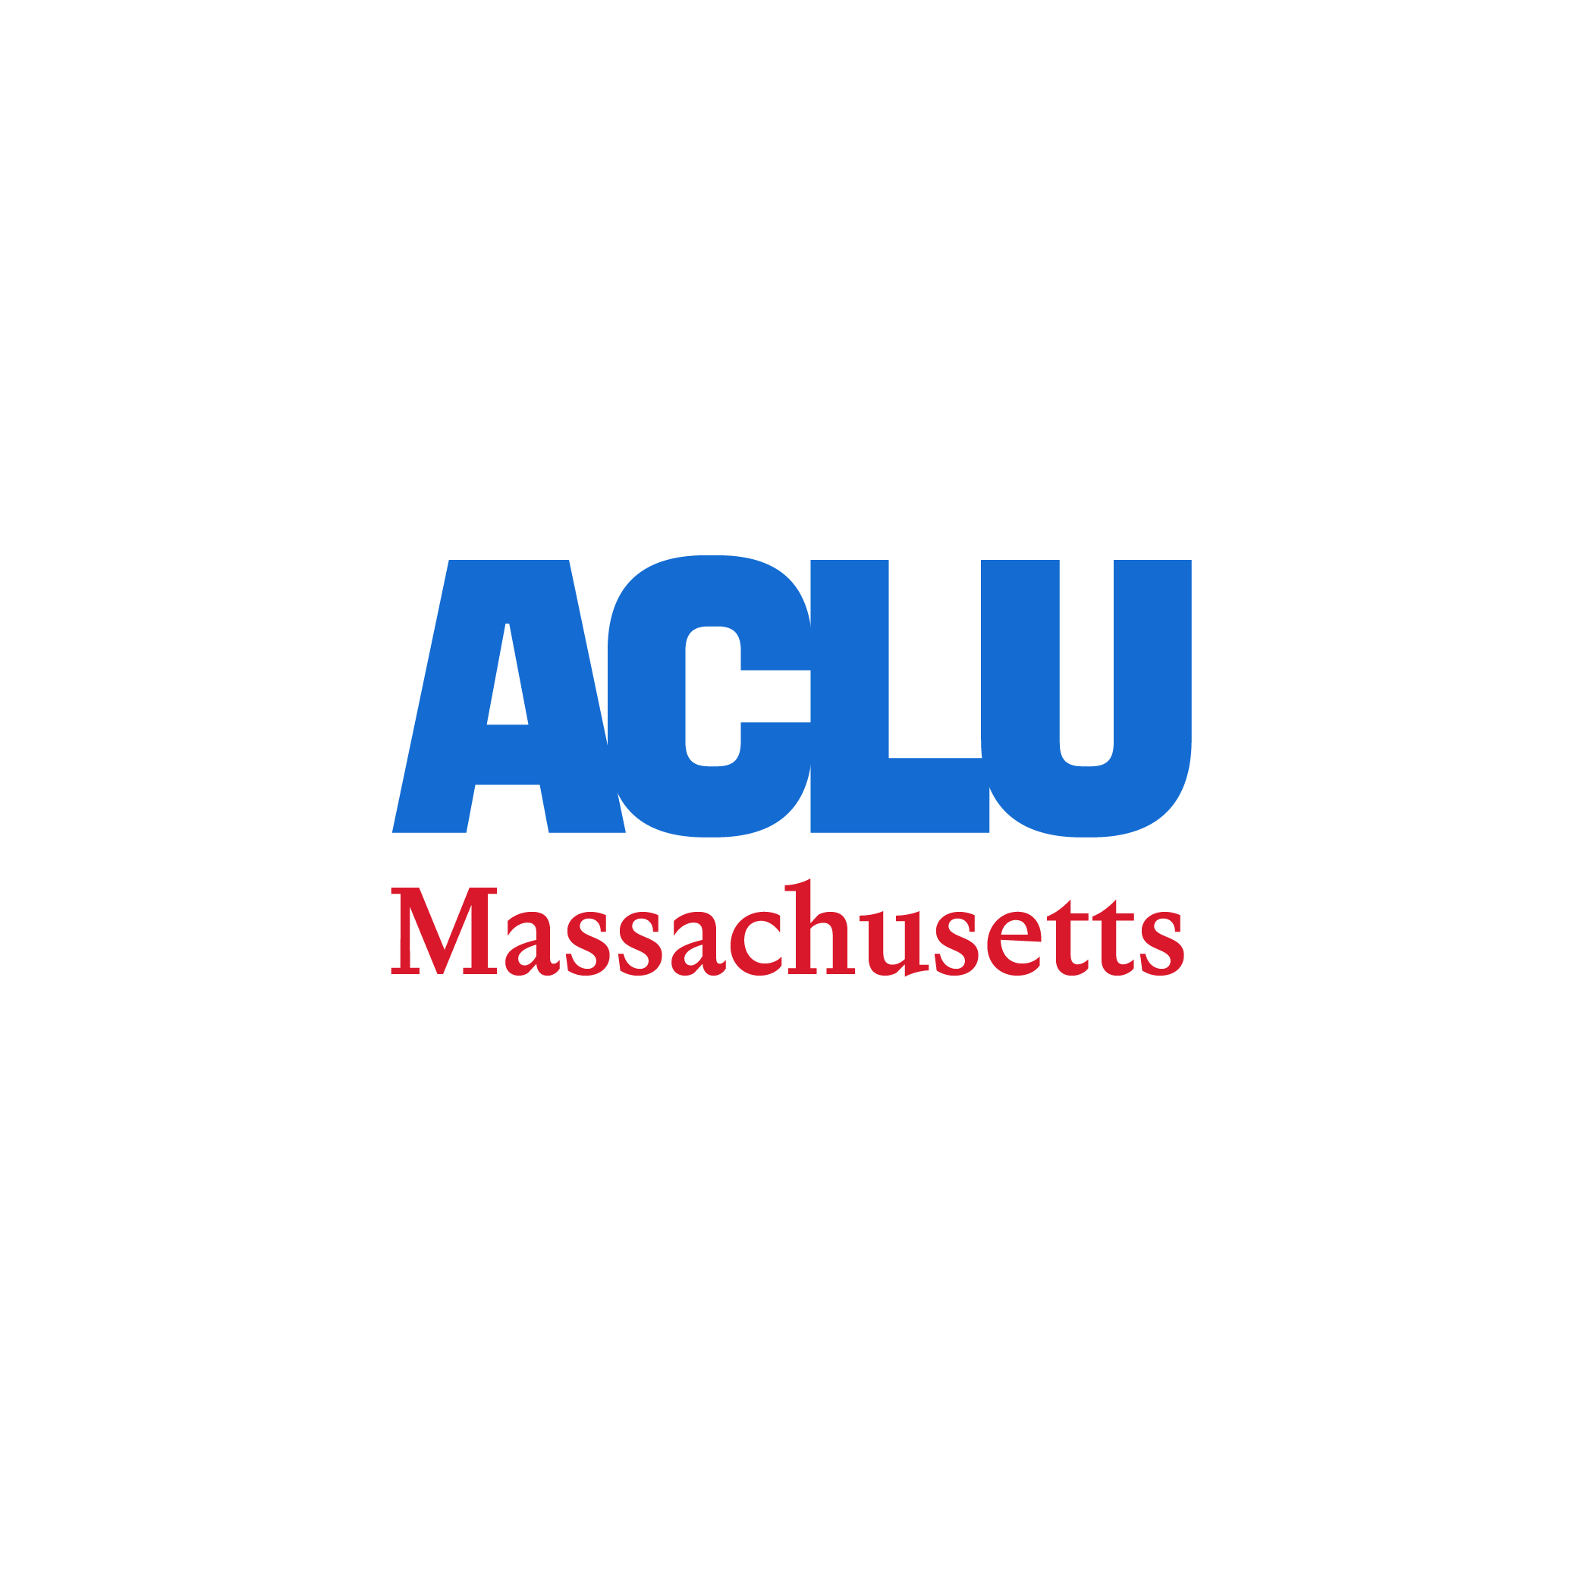
We can protect public safety while acting in accordance with our community’s values.
This means rejecting Flock.
Flock's business model encourages police departments to opt into nationwide data sharing.
Flock's standard contract includes language that may give it the right to share police department data, even when a department chooses to restrict data sharing.
Unrestricted data sharing is a problem because Massachusetts drivers' location information can and has been shared with immigration enforcement authorities and police departments that are enforcing restrictive abortion and gender-affirming care laws.
No process or mechanism to limit data sharing will be completely adequate.

Slide 3
Flock’s business model: National database and Nationwide Data Sharing
Flock advertises "Multi-State Crime Solving" which gives police departments the power to "Track suspects across counties and state lines with seamless data sharing and national plate visibility."
National data sharing may lead to inadvertent assistance with civil immigration enforcement, putting immigrants at risk of detention and/or deportation.
  Policies like welcoming community ordinances often prohibit local officials from assisting federal immigration enforcement efforts.
It also may lead to violations of the Massachusetts Shield Law, putting healthcare providers and care seekers at risk.
  The Shield Law prohibits Massachusetts law enforcement from providing information or assistance to any other state’s law enforcement agency in relation to investigations into reproductive healthcare
  or gender-affirming healthcare that is lawful in the Commonwealth.

Slide 4
Over 80 PDs in MA use Flock—there are other providers as well
MA has no regulations on LPRs
Legislation is currently before House Ways and Means
Nationwide or regional databases make accountability impossible, and endanger us all
Other states in New England have regulated LPRs, but not Massachusetts
Legislation filed by Rep. Owens (H.3755) would prohibit database pooling, require warrants for sharing

Slide 5
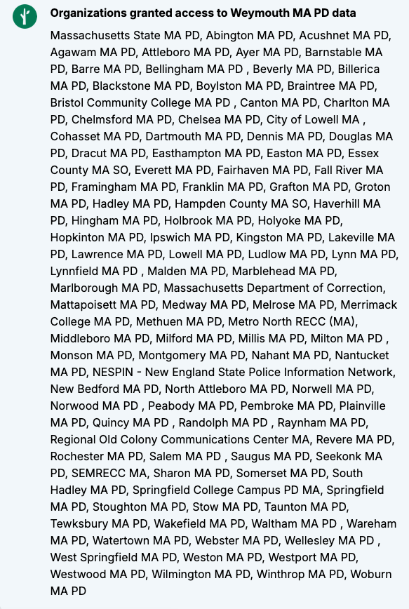

Slide 6
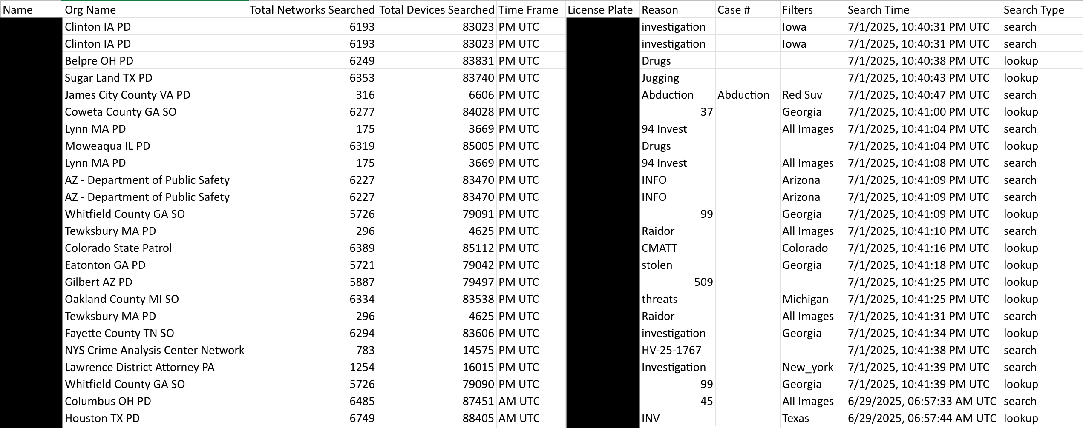
Example: Flock Network Audit

Slide 7
Flock is Sharing License Plate Reader Data on A Massive Scale
Network of approximately 90,000 license plate reader cameras across the country
In one Massachusetts police departments' network audit received in response to a recent public records request, there were over 2.6 million searches of Flock's nationwide database in just the first half of 2025.
  Of these 2.6 million searches, nearly 1,500 included an explicit search reason including "immigration" or "ICE"
  Also included in these searches, which query data from Massachusetts police departments and the drivers in each jurisdiction, was a search from a police officer in Texas looking for a woman who had a self-managed abortion.

Slide 8
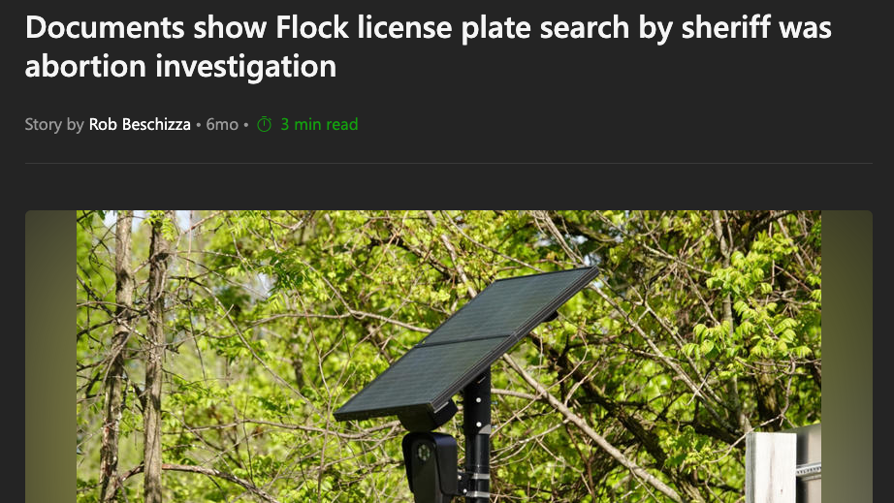

Slide 9
Johnson County, Texas abortion search of Flock’s Database
Earlier this year, police in Johnson County, Texas performed a nationwide search in Flock’s database to locate a woman who they believed had a self-administered abortion.
We know about this investigation because the Texas officer entered “had an abortion, search for female” in the “Reason” field in Flock’s database.
Initially, Flock tried to dismiss criticism stemming from the negative press, suggesting that the woman’s “family feared she was hurt” and that police merely sought to make sure that she was alright.
But subsequent reporting from 404 Media based on public records obtained by the Electronic Frontier Foundation show the police who made this search were pursuing the
woman as part of a “death investigation” into the abortion.

Slide 10
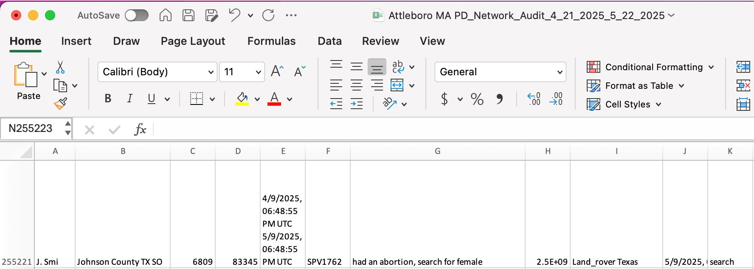
Johnson County, Texas abortion search of Flock’s Database

Slide 11
Immigration-Related searches:
Welcoming Community Ordinance issues
Local policies such as welcoming community ordinances often prohibit local officials from assisting federal immigration enforcement efforts.
That's exactly what Flock's national database is used for all the time.
  Flock had a contract with Customs and Border Patrol.
  Hundreds of 2025 searches state "ICE" or "immigration" in the search reason field.
  Flock actively shares data with out-of-state police departments (e.g., Florida Highway Patrol) that are deputized to support immigration detention and enforcement.
    In the first half of 2025, the Florida Highway Patrol made over 12,000 searches of Flock's nationwide database, which includes many Massachusetts drivers' location information.

Slide 12
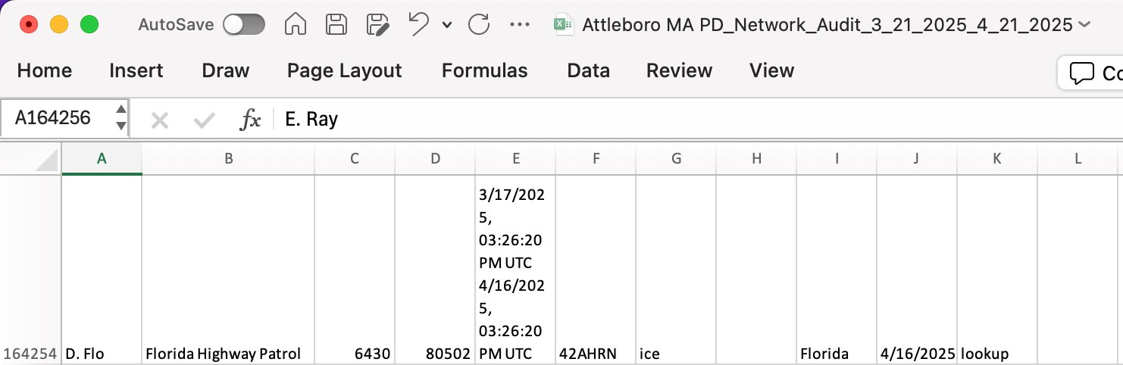
Immigration-Related searches:
Welcoming Community Ordinance issues

Slide 13
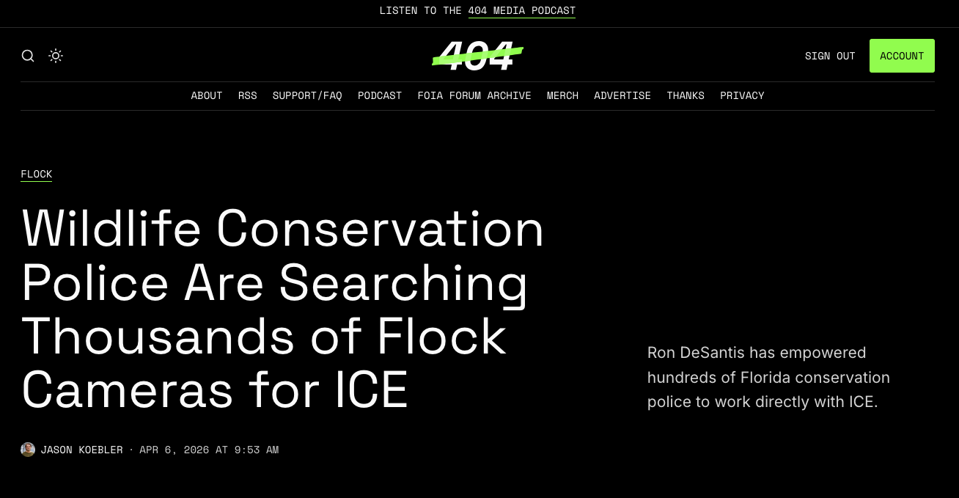

Slide 14
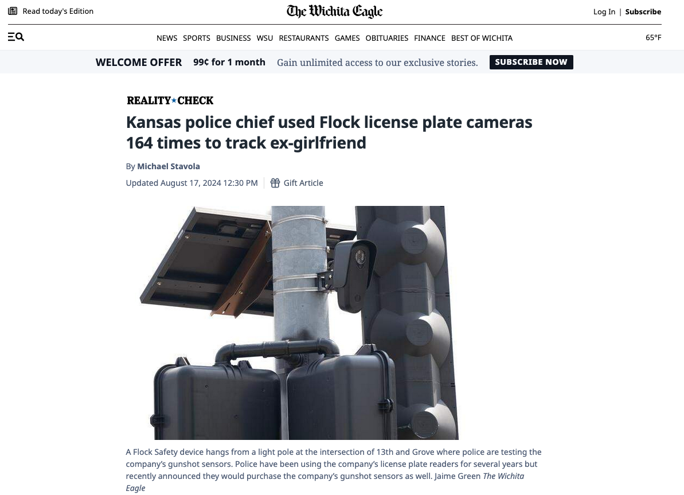

Slide 15
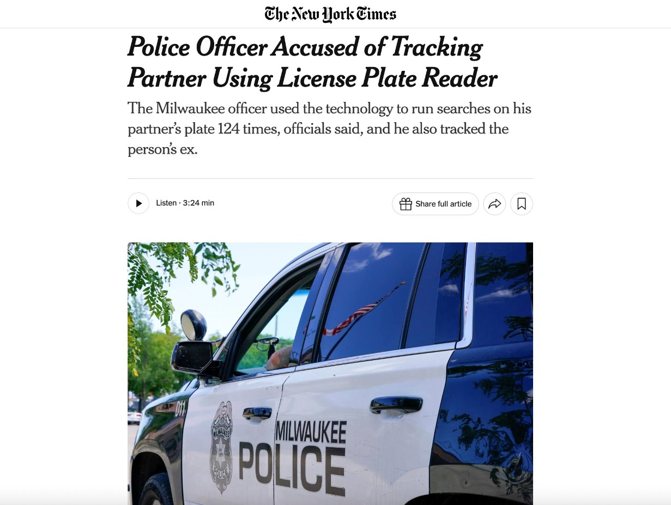

Slide 16
Data Security: Multi-Factor Authentication and Hacking Concerns
In November 2025, Senator Ron Wyden and Rep. Raja Krishnamoorthi sent a letter calling on the FTC to investigate Flock for its failure to require customers to use industry standard security measures to protect their accounts.
The lack of data security measures has led to serious cybersecurity breaches of Flock’s data.
  Flock does not require its law enforcement customers to use multi-factor authentication.
The members of Congress pointed to at least 35 cases in which Flock passwords had been stolen, and evidence “from a Russian-language cybercrime forum in which Flock accounts appear to be offered for sale.”

Slide 17
Rejecting Flock is The Only Way to protect Local Residents
No matter what sharing permissions your local police department chooses in Flock's system, ICE and CBP can use legal process to force Flock to give them data on Massachusetts residents' location information.
Search reasons entered by external law enforcement are unreliable and often non-descriptive (e.g., merely stating "investigation" or "wanted").
Even if a given police department limits sharing to certain departments, external law enforcement can easily share login credentials or specific license plate reader data.
Flock's nationwide license plate reader database is an exceedingly powerful tool. Law enforcement officers can easily abuse access and make unauthorized searches.

Slide 18
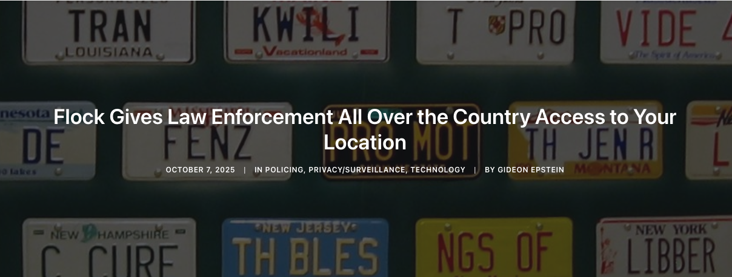

Slide 19
Questions?
If you have follow-up questions, email me at gepstein@aclum.org

Slide 20
Sources
Flock Safety: https://www.flocksafety.com/
404 Media: https://www.404media.co/
Electronic Frontier Foundation: https://www.eff.org/
Associated Press: https://apnews.com/
Massachusetts Shield Law: Mass. Gen. Laws ch. 147, § 63(b)
See e.g., Cambridge Welcoming Community Ordinance: Cambridge, Mass., ch. 2.129
ACLU of Massachusetts Public Records Requests and Responsive Documents
Letter from Senator Ron Wyden and Representative Raja Krishnamoorthi, to
Federal Trade Commission Chair Andrew N. Ferguson (Nov. 3, 2025)

